Slide 1
Navigation and Inertial Measurements
Lecture 11-01
RBE500
Adj. Prof. J. Center

Slide 2
General Navigation Problem

Slide 3
Using Sensor Data
Consider the problem of determining the location and heading of a platform (or parts of a platform):
Relative position – we can determine position as a change from a known pose.
Absolute position – we can determine pose within a known coordinate system.

Slide 4
Relative Position
Determining relative pose implies “dead reckoning”:
Assumes some known starting point.
Sensors measure some “advance” from that starting point.
Prone to accumulation of errors.
Errors may be reasonably bounded by periodic recalibration
Position Fixes -- Absolute fixes
Velocity Fixes -- Zero-velocity Updates
Etc.

Slide 5
Dead Reckoning Sensors
There are two basic types of sensors that provide data to a dead reckoning system:
Odometry – Odometry sensors measure displacement or orientation as a function of time.
Inertial – Inertial sensors measure physical parameters like acceleration or rotation relative to an inertial reference frame.

Slide 6
Review of Odometry

Slide 7
Odometry Sensors
Odometry sensors are among the most common of robot platforms.
They take many forms:
Rotation sensors
Some kind of encoder is used to measure wheel rotation. Or, less accurately, motor current.
Knowing the amount of rotation and the wheel diameter and wheel spacing, a displacement can be determined.

Slide 8
Example Differential Drive Robot
Consider an example of a simple robot system which uses differential drive:

Slide 9
A Differential Drive Example
With both wheels driven, at any time, t, the system can be viewed as rotating along its instantaneous center of curvature (ICC):

Slide 10
Differential Drive
In this situation, the direction and velocity of the platform is controlled by the speed of the left and right wheels.
Let’s make some assumptions:
Wheels stay in contact with the ground.
Wheels are a fixed and equal diameter, D.
Wheels are separated by a fixed distance, L, from the center of the axle.
R is the distance from the center of the axel to the Instantaneous Center of Curvature (ICC)
No bumps.

Slide 11
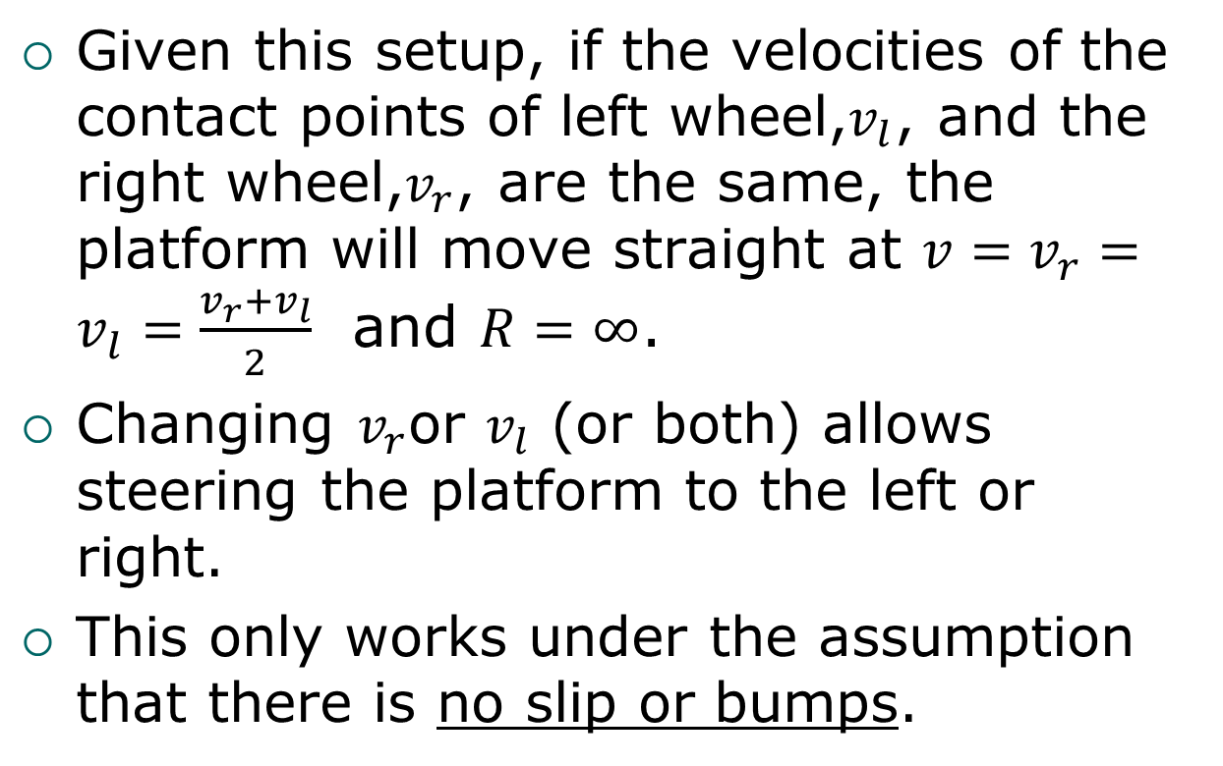
Differential Drive Characteristics
Given this setup, if the velocities of the contact points of left wheel,$v_{l}$, and the right wheel,$v_{r}$, are the same, the platform will move straight at $v=v_{r}=v_{l}=\frac{v_{r}+v_{l}}{2}$ and $R=∞$.
Changing $v_{r}$or $v_{l}$ (or both) allows steering the platform to the left or right.
This only works under the assumption that there is no slip or bumps.

Slide 12


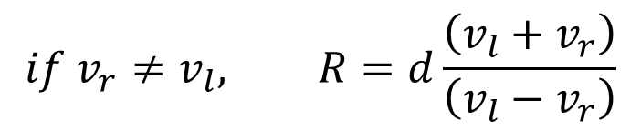
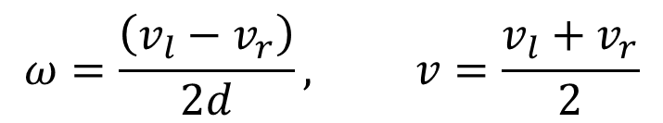

Differential Drive Equations
Mathematically, we have:
with $d=\frac{L}{2}$, or
and instantaneous velocity, $v=ωR=\frac{v_{r}+v_{l}}{2}$
$$ω\left(R−d\right)=v_{r}$$
$$ω\left(R+d\right)=v_{l}$$
$$ω=\frac{\left(v_{l}−v_{r}\right)}{2d}, v=\frac{v_{l}+v_{r}}{2}$$
$$if v_{r}≠v_{l}, R=d\frac{\left(v_{l}+v_{r}\right)}{\left(v_{l}−v_{r}\right)}$$

Slide 13
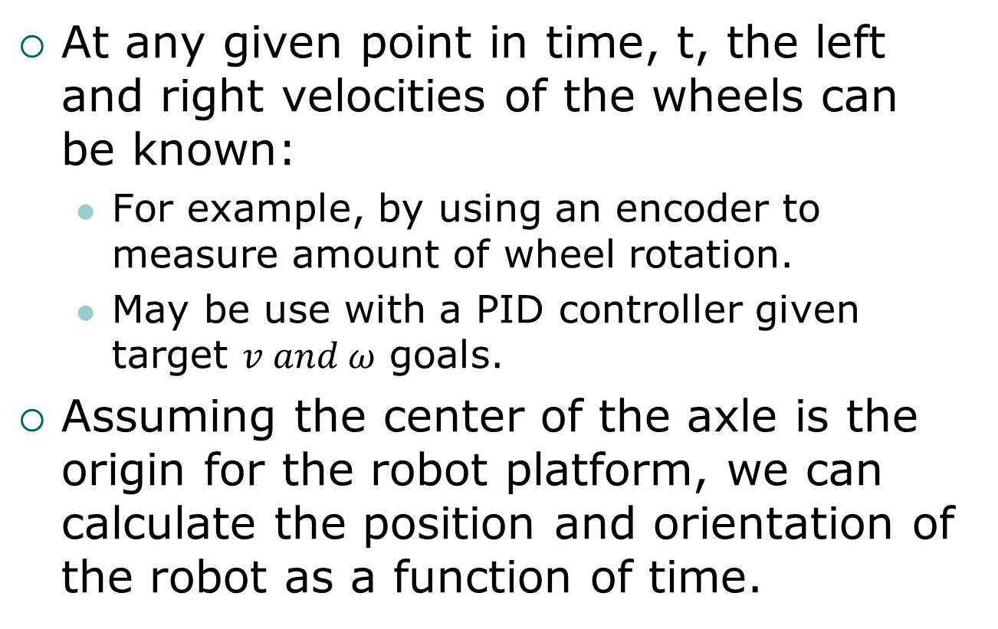
Determining Position and Orientation
At any given point in time, t, the left and right velocities of the wheels can be known:
For example, by using an encoder to measure amount of wheel rotation.
May be use with a PID controller given target $v and ω$ goals.
Assuming the center of the axle is the origin for the robot platform, we can calculate the position and orientation of the robot as a function of time.

Slide 14
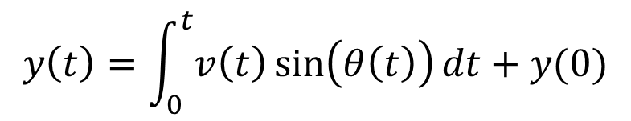
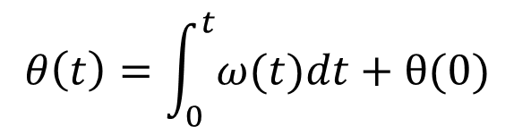
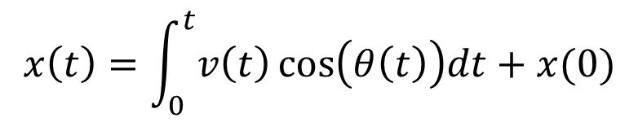
Determining Position and Orientation
Assuming a Cartesian coordinate system:
$$x\left(t\right)=\int_{0}^{t}{v\left(t\right)\cos\left(θ\left(t\right)\right)dt+x(0)}$$
$$y\left(t\right)=\int_{0}^{t}{v\left(t\right)\sin{⁡\left(θ\left(t\right)\right)}dt}+y(0)$$
$$θ\left(t\right)=\int_{0}^{t}{ω(t)dt}+θ(0)$$

Slide 15
Accumulated Errors
It is in the underlying assumptions (and the integration) that result in accumulated errors:
Mechanical tolerances and stability of wheel spacing and diameter.
Flatness and traction of travel surface.
Electrical/mechanical tolerances measuring (and maintaining) wheel velocity. (e.g. missing interrupts or timing errors.)

Slide 16
“Momentary” Errors
The integration that is part of dead reckoning. This means that even transient errors in determining orientation will result in a constantly increasing position error.
Further, any biases in the system are continuously “integrated in” to the position and orientation solution.

Slide 17
Rotational Sensors
The differential drive example is one simple way of controlling the velocity and orientation of a robot.
For other steering mechanisms, some indication of the orientation of the steering mechanism is needed.
As well as modifications to the math to account for the steering and drive having different origins.
Thus, we need rotational sensors.

Slide 18
Rotation Sensors
Rotation sensors come in a variety of forms:
Incremental encoders – determine displacement of a shaft from a known starting point
Absolute encoders – provide a direct indication of the position of a shaft.

Slide 19
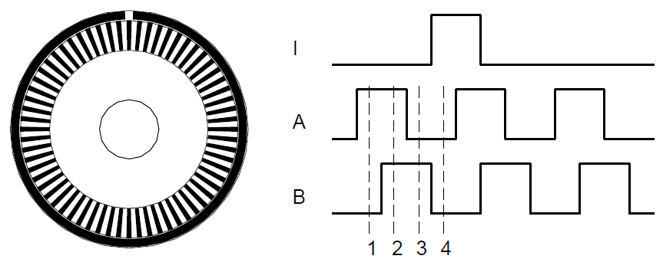
Incremental Encoder
A common example of an incremental encoder is a quadrature encoder.
Allows determining direction and amount of rotation:

Slide 20
Incremental Encoders
Work well for measuring relatively small amounts of rotation
Limited by optical resolution and interrupt conflicts.
“Index” can provide a count of whole rotations, but many encoder do not have this.
Eventually, quantization or interrupts conflicts may cause missed counts or timing errors.
Even with an index mark, an encoder only indicates actual shaft position at one point.

Slide 21
Absolute Encoders
An absolute encoder provides a way to directly measure the orientation of a shaft:

Slide 22
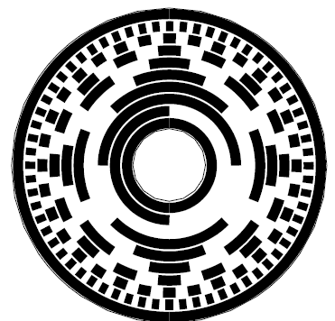
Absolute Encoder
These systems typically use a Gray-coded disk to allow encoding absolute shaft position”
These sensors tend to be most commonly used in low-speed applications needing 10-12 bits of resolution.

Slide 23
Heading Sensors
To detect drift while dead reckoning using odometry, it is possible to include other measures of orientation:
These may include:
Magnetometer / Compass
Angular rate sensor – Gyroscope.
Velocity sensor – Accelerometer.

Slide 24
Inertial Systems

Slide 25
INS versus IMU
There are two terms that are often used incorrectly and/or synonymously when discussing inertial systems. An INS is an “Inertial Navigation System”
An INS, therefore, produces a navigation solution.
An IMU is an “Inertial Measurement Unit”
An IMU measures physical properties that may be used by the INS.

Slide 26
Sensors - Accelerometers
Typically suspends a mass on a spring or pendulum.
Measures the displacement of a proof mass.
Displacement of the proof mass is proportional to the force along the axis of the sensor.

Slide 27


Accelerometers
Modeled by:
where l is the displacement, m is the mass, k_{v} is the damping coefficient, and k_{e} is the spring coefficient.
In steady state:
$$m\ddot{l}+k_{v}\dot{l}+k_{e}l=F$$
$$−k_{e}l=F$$

Slide 28
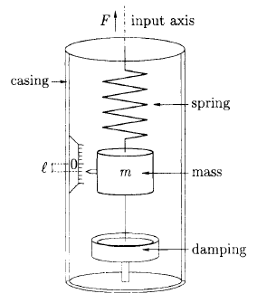
Spring Accelerometer
Measuring the displacement, l, provides a measure of force F.
However, this is only true in steady state.
This means that there is a limit on how fast the accelerometer can react to changes in force.
This limit is a function of the spring and damping coefficients.

Slide 29
Vibrating Accelerometer
When a mass hangs from a wire, an acceleration in the direction of the mass will tend to stretch or compress the wire.
Like a guitar string, this change in tension results in a change in resonant frequency of the wire.
Since resonant frequency is proportional to acceleration, measuring frequency measures acceleration.

Slide 30
MEMS Accelerometers
Spring and vibratory mass can be built to achieve very accurate measurements.
This accuracy, however, is achieved at substantial expense.
Thus, there is a market for low-cost alternatives – Enter the MEMS accelerometer.

Slide 31
Vertical Accelerometer Measurements
The “acceleration” measurement in the vertical direction measures the force countering gravity, not just F=ma.
Therefore, a gravity model is needed to correct this measurement, or knowledge that the vehicle is moving on a flat surface can be used to eliminate the erroneous vertical motion estimate.

Slide 32
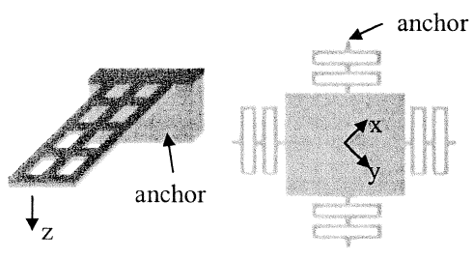
Measuring Acceleration
There are many MEMS accelerometer configurations.
Most involve measuring changes in capacitance when a proof mass moves relative to the substrate.

Slide 33
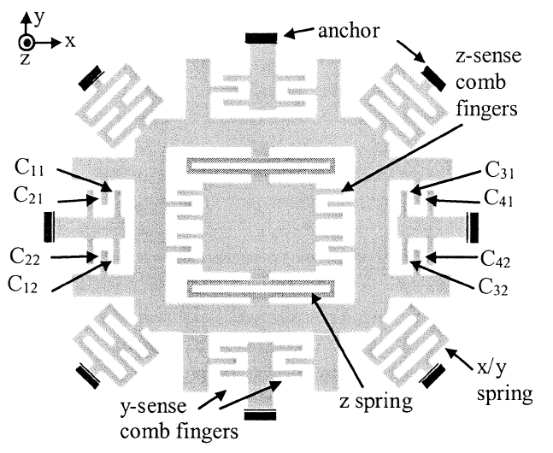
3-Axis MEMS Topology

Slide 34
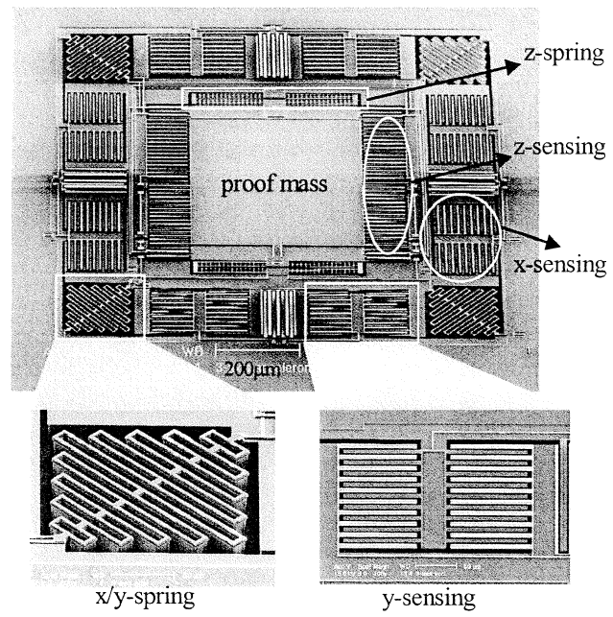
3-Axis Device

Slide 35
Accelerometer Bias
The accelerometer bias is a “constant” value that is present when the accelerometer is stationary.
Bias occurs (primarily) due to:
DC offset in the sensor electronics.
Mechanical offset of the accelerometer relative to gravity.
It may take a LONG time to stabilize!

Slide 36

Effect of Bias
Extracting position from acceleration requires double integration.
Assuming a constant bias, ε, the effect on position is quadratic with time:
Unless corrected, this eventually results in extreme degradation of position and velocity estimates.
$$x\left(t\right)=ε∙\frac{t^{2}}{2}$$

Slide 37
Compensating for These Effects
This bias is a cumulative effect.
Like odometry, over the short term, an INU can be very accurate.
One common approach is to “reset” the INU initial parameters periodically.
These “resets” can involve simply stopping (velocity fix), and readjusting biases and their accumulated effects.
They may involve “resetting” by using information from an absolute positioning system periodically (position fix).

Slide 38
Effects of Noise
The noise in an accelerometer tends to consist of two parts.
Over short time periods, it looks fairly white
Over longer time periods, it begins to look Markov.
There is a great temptation to identify accelerometer data as “noisy” and “filter” it.

Slide 39
Filtering Noise
A filter essentially averages a signal to reduce the instantaneous fluctuations.
Put another way, filtering effectively integrates the noise.
This, in turn, changes the statistics of the noise.
Integrating the noise, creates a random walk which has a variance which grows as t^{1/2}

Slide 40
What this means…
So, the bias errors result in continually increasing position errors.
Integrating the accelerometer noise results in increasing velocity variance.
In addition, we have:
Bias stability – bias tends to wander over time.
Temperature – non-linear bias change with temp
Calibration errors – scale, alignment, linearity.

Slide 41
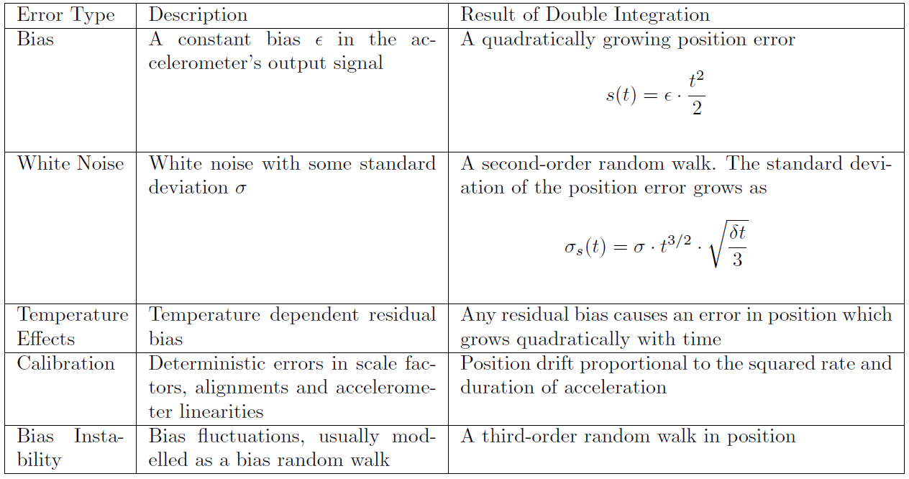
Accelerometer Error Summary

Slide 42
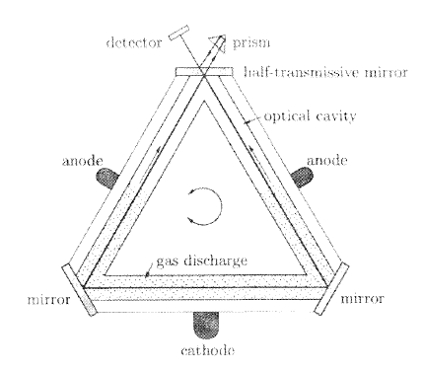
Gyroscopes
Early gyroscopes were mechanical, involving a spinning flywheel.
Current high-quality gyros tend to be laser or fiber optic gyros.

Slide 43
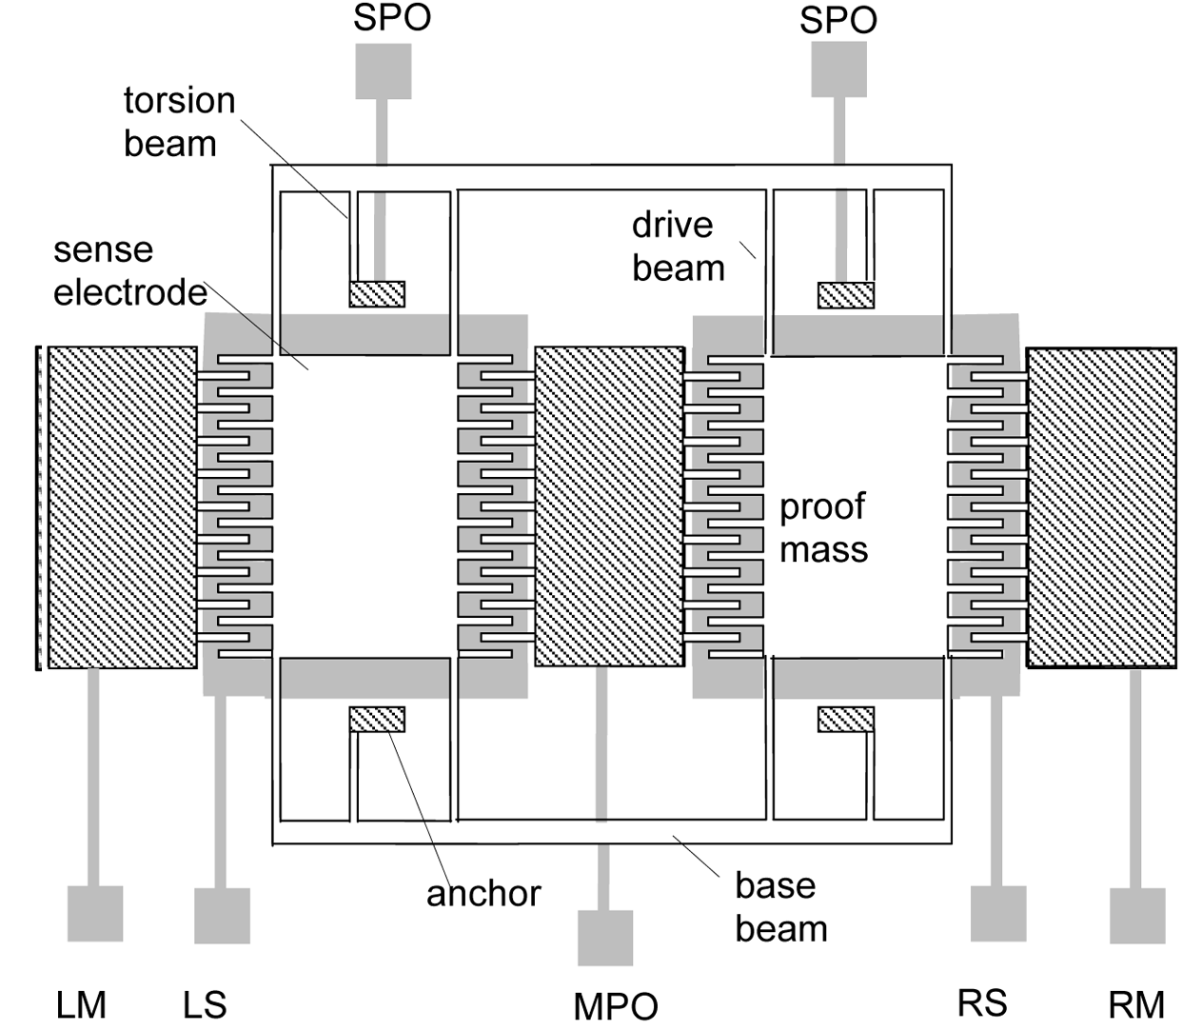
Vibratory MEMS Gyroscope

Slide 44
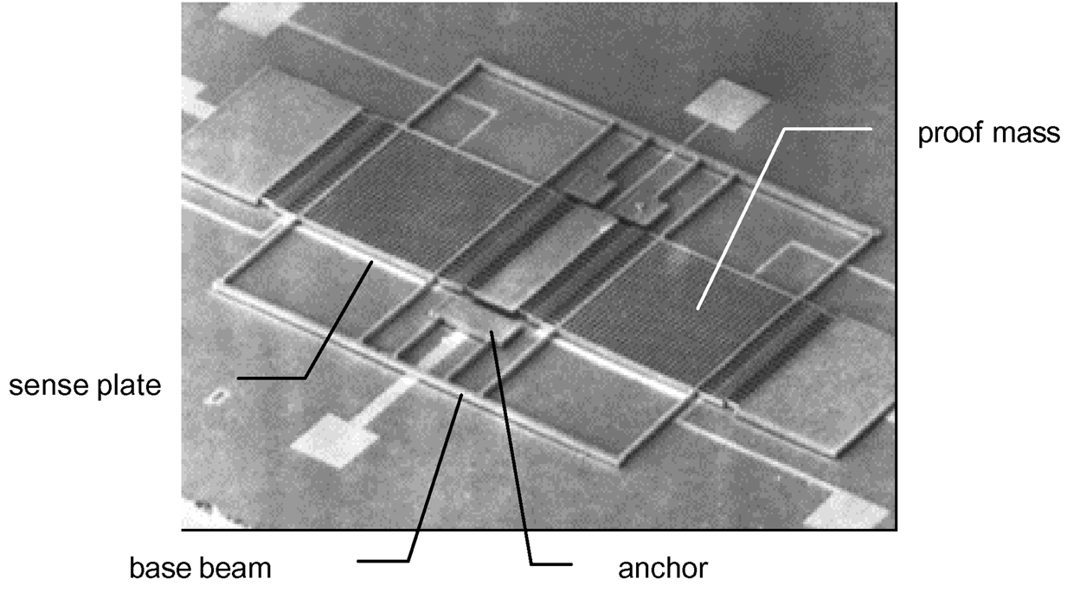
MEMS Gyroscope Device

Slide 45
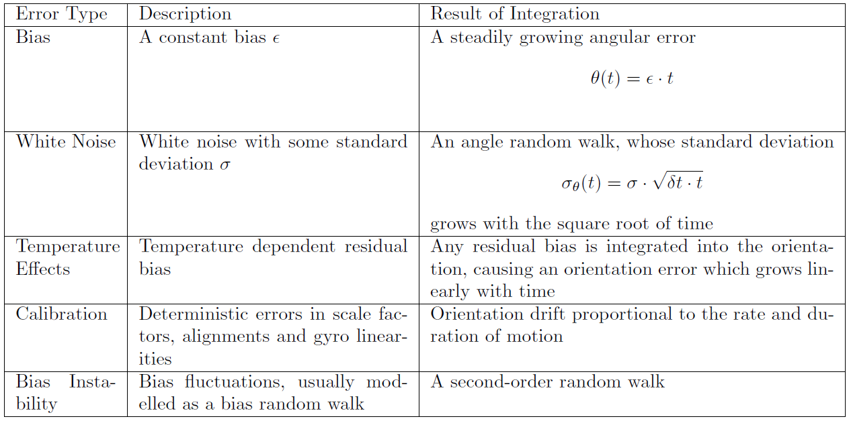
Gyro Error Sources

Slide 46
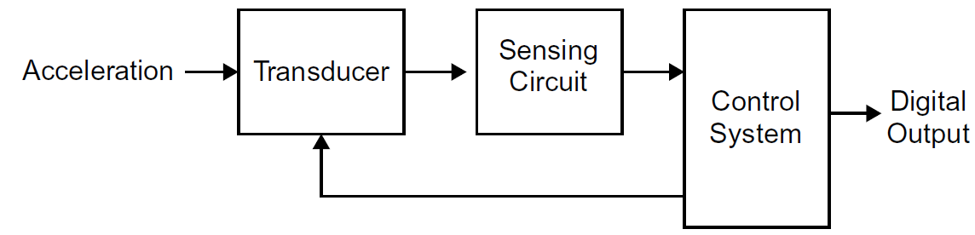
Sensing Electronics
A generic accelerometer/gyro block diagram is:

Slide 47
Inertial Measurements
Because the error mechanisms are independent, it is common to combine odometry with inertial navigation.
While inertial systems have problems (drift) for navigation systems, they also have some advantages:
High update rate.
Potential high accuracy.

Slide 48
Types of Inertial Systems
There are basically two different “flavors” of inertial systems.
“Strapdown” Inertial Navigation
In a strapdown inertial system, the IMU is fixed to the body (platform). Thus the orientation of the body and the IMU changes as one.
“Gimbaled” Inertial Navigation
In a gimbaled inertial system, the IMU stays in the inertial (navigation) frame and the body moves around it.

Slide 49
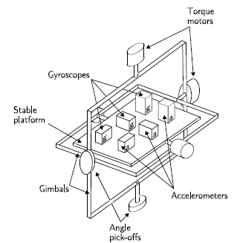
A Gimbaled IMU
A gimbaled (or “stable” platform) allows the IMU to rotate freely to maintain alignment with the navigation frame.

Slide 50
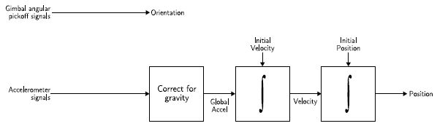
Stable Platform Navigation
Since a stable platform stays in the navigation frame, the basic idea is pretty straightforward:

Slide 51
Strapdown Navigation Issues
In a strapdown system, things get a little more complicated.
The orientation of the accelerometers will now change as the platform orientation changes.
Thus, the meaning of the accelerometer information depends on knowing how the orientation has changed relative to the navigation frame.
These changes are often measured using gyroscopes to measure pitch, roll and yaw.

Slide 52
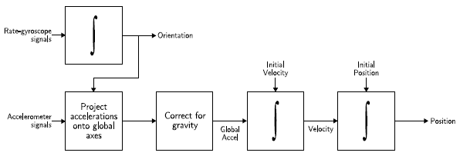
Strapdown Navigation
A strapdown system is mechanically simpler, but adds some computational complexity (and an additional source of error).
Same processing as gimbaled system

Slide 53
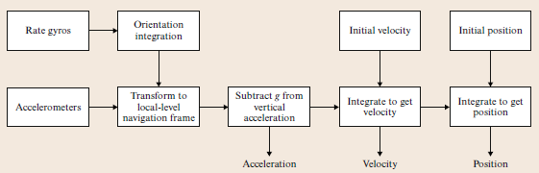
A Simplified INU
The simple approach to creating an INU is to first compensate for platform orientation and then integrate:

Slide 54
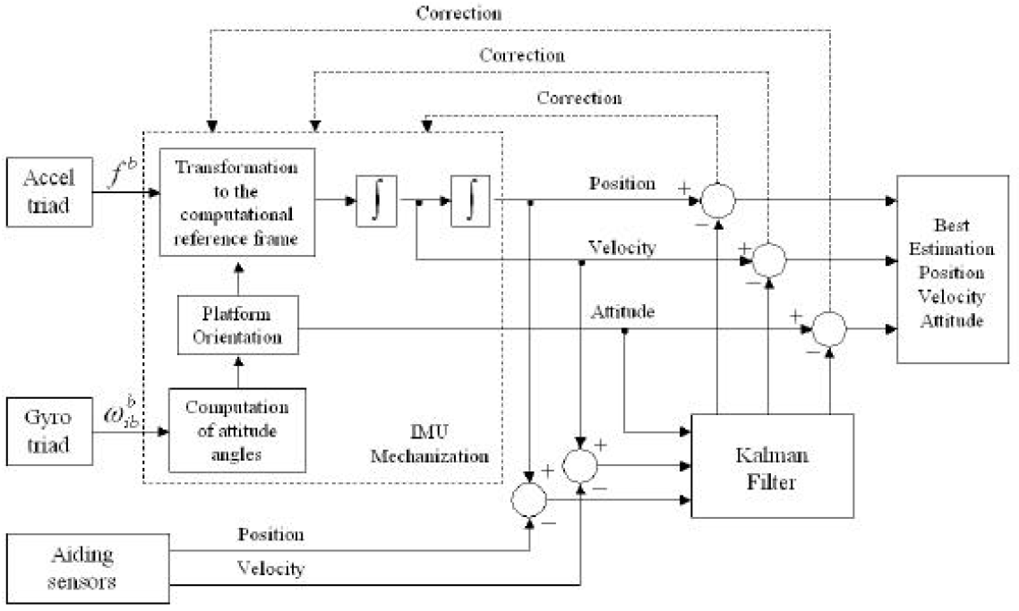
A More Realistic System

Slide 55
Simple Accelerating Body
Consider a 3-axis accelerometer sliding across a table.
We’d expect an increase in acceleration as the body begins moving.
Little acceleration while at constant velocity.
Decrease in acceleration as the body comes to a stop.

Slide 56
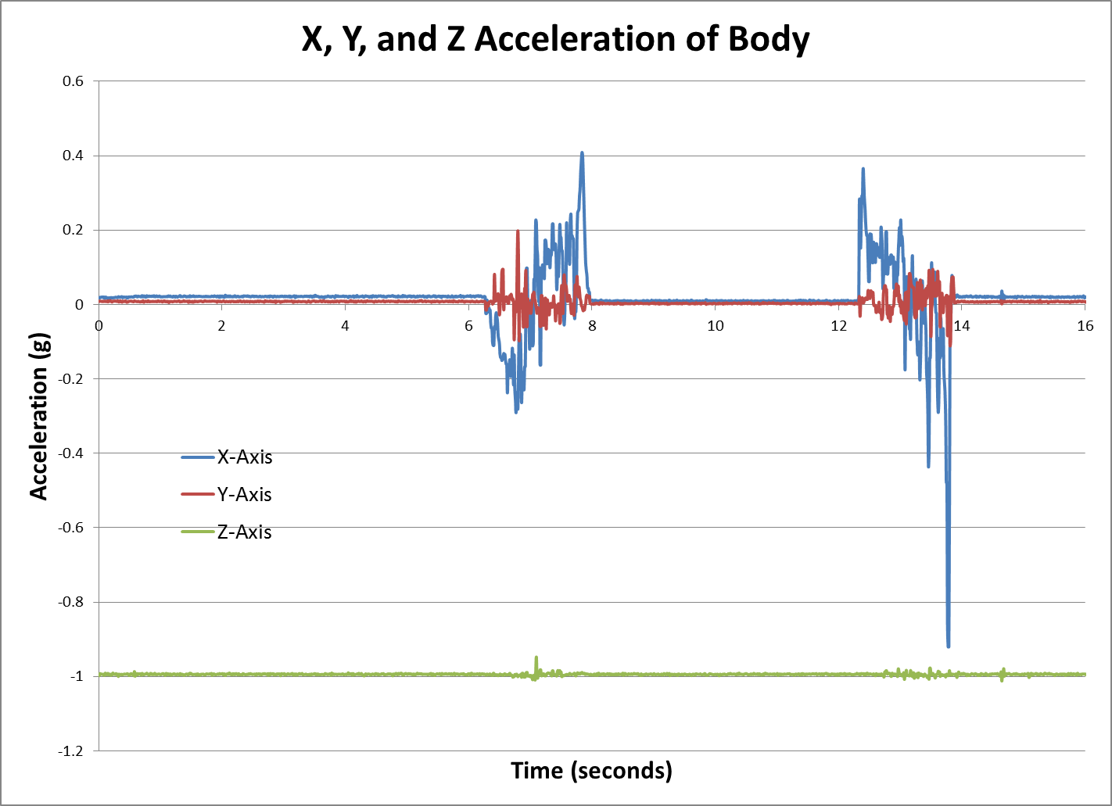
Sliding Across a Table – Raw Data

Slide 57
Movement Was Along X Axis
From the raw data we see a couple of things of note:
Movement was along the X-Axis, but there are artifacts in Y and Z as well.
Slight biases in X, Y and Z
0-6 second region
X-Axis: mean = 0.022, std = 0.0013
Y-Axis: mean = 0.008, std = 0.0009
Z-Axis: mean = -0.994, std = 0.0014

Slide 58
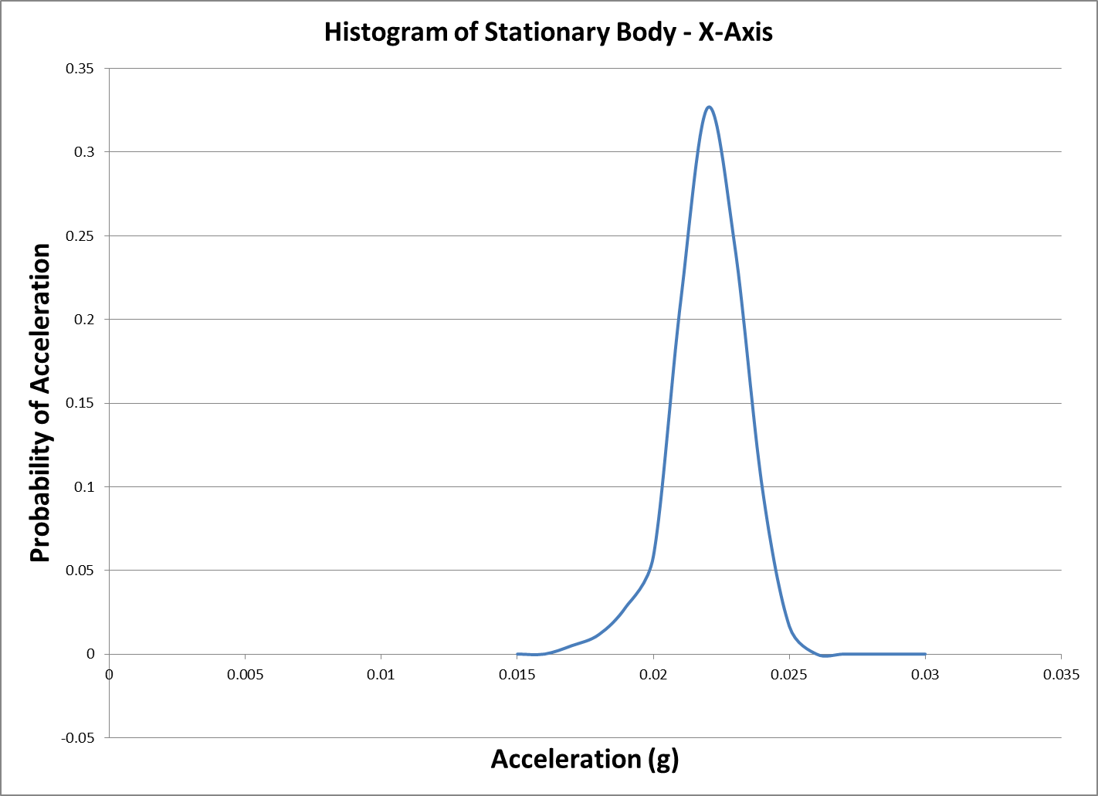
X-Axis Histogram – 0-6 Seconds

Slide 59
Calibration Data
This offset is due to a number of factors:
Mechanical offset of accelerometer
Gravity vector projects onto X and Y axes.
Electrical bias
These error mechanisms both appear as a constant acceleration term!

Slide 60
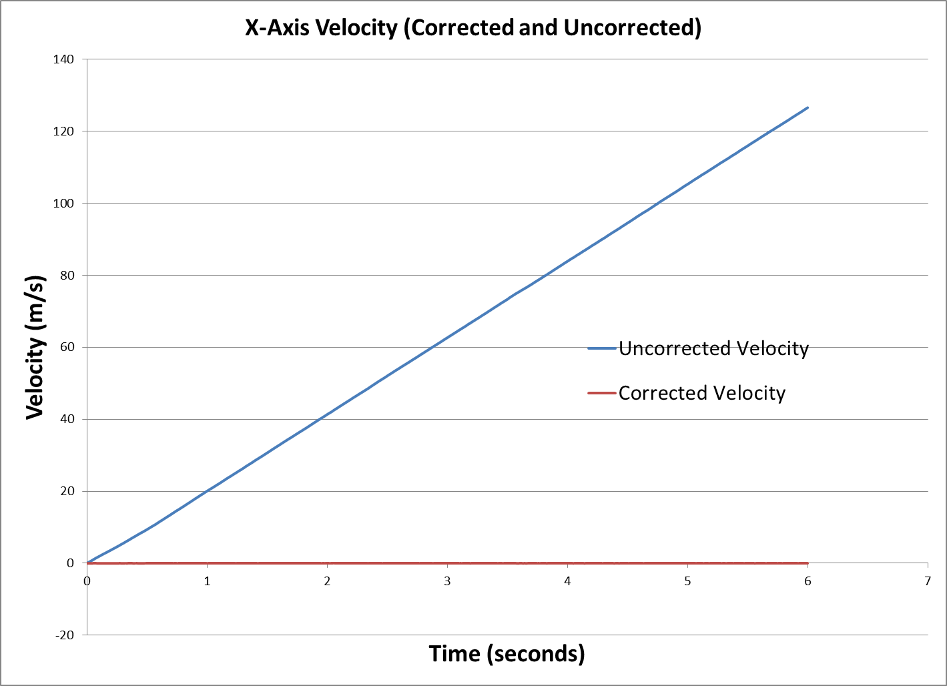
“Velocity” of Stationary Body

Slide 61
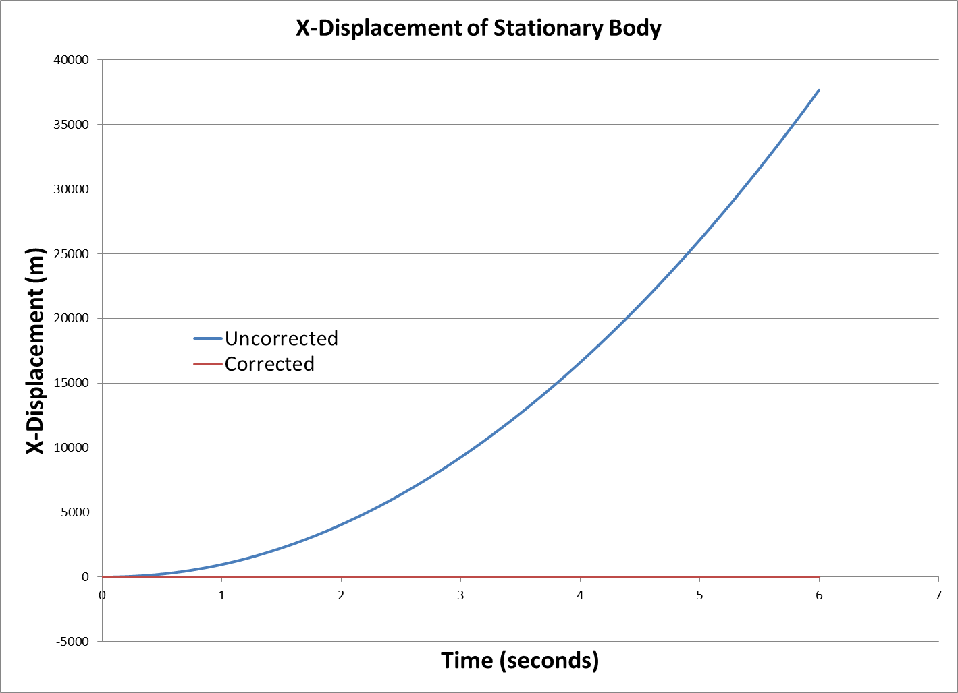
“Position” of a Stationary Body

Slide 62
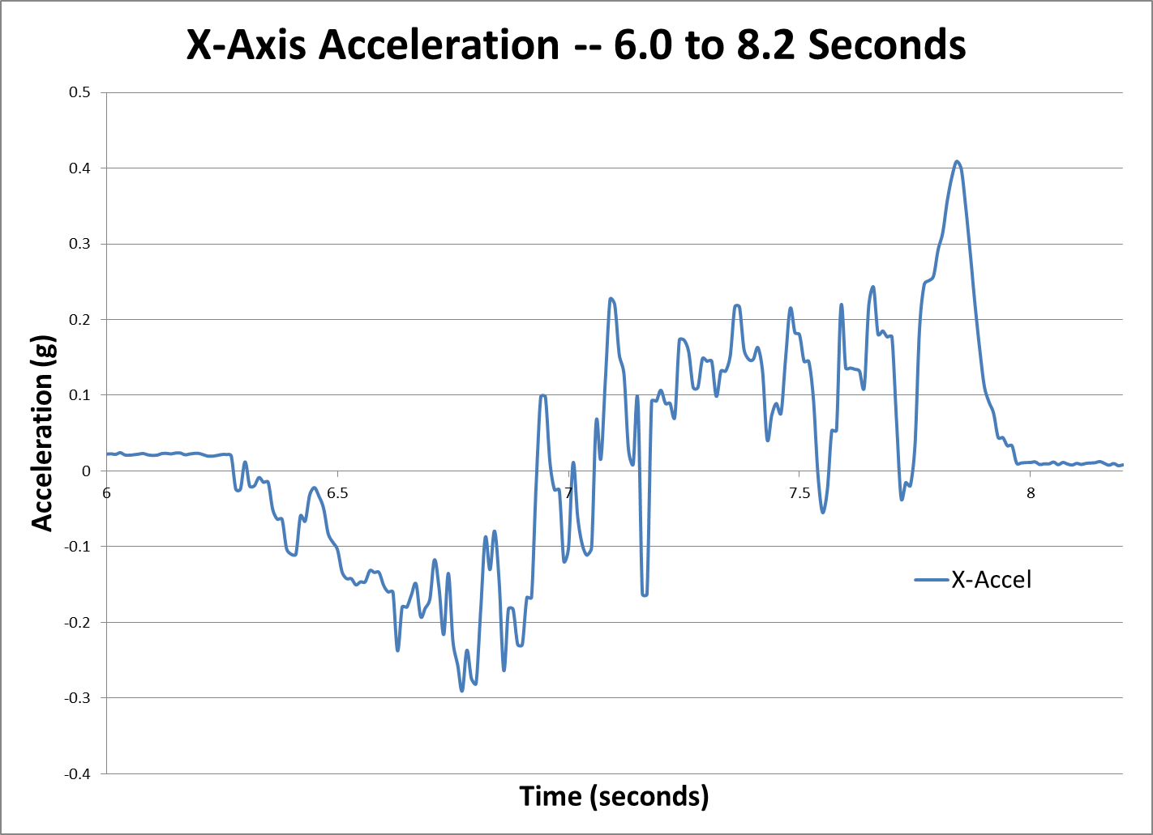
Acceleration Region – 6-8 Secs

Slide 63
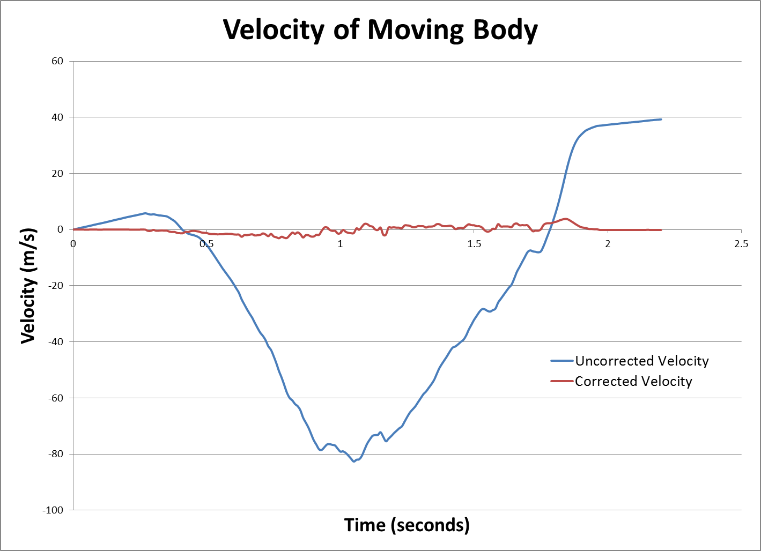
Velocity Data

Slide 64
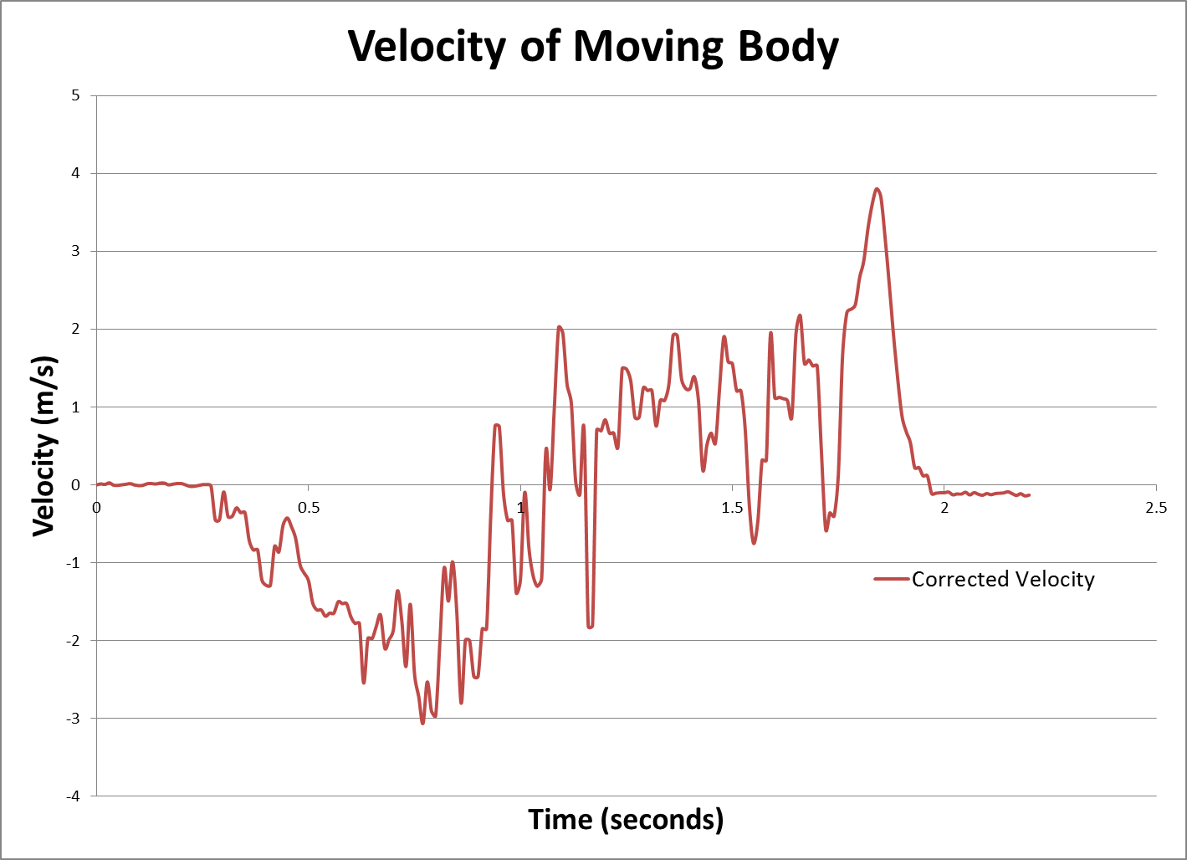
Velocity of Moving Body – Fine Scale

Slide 65
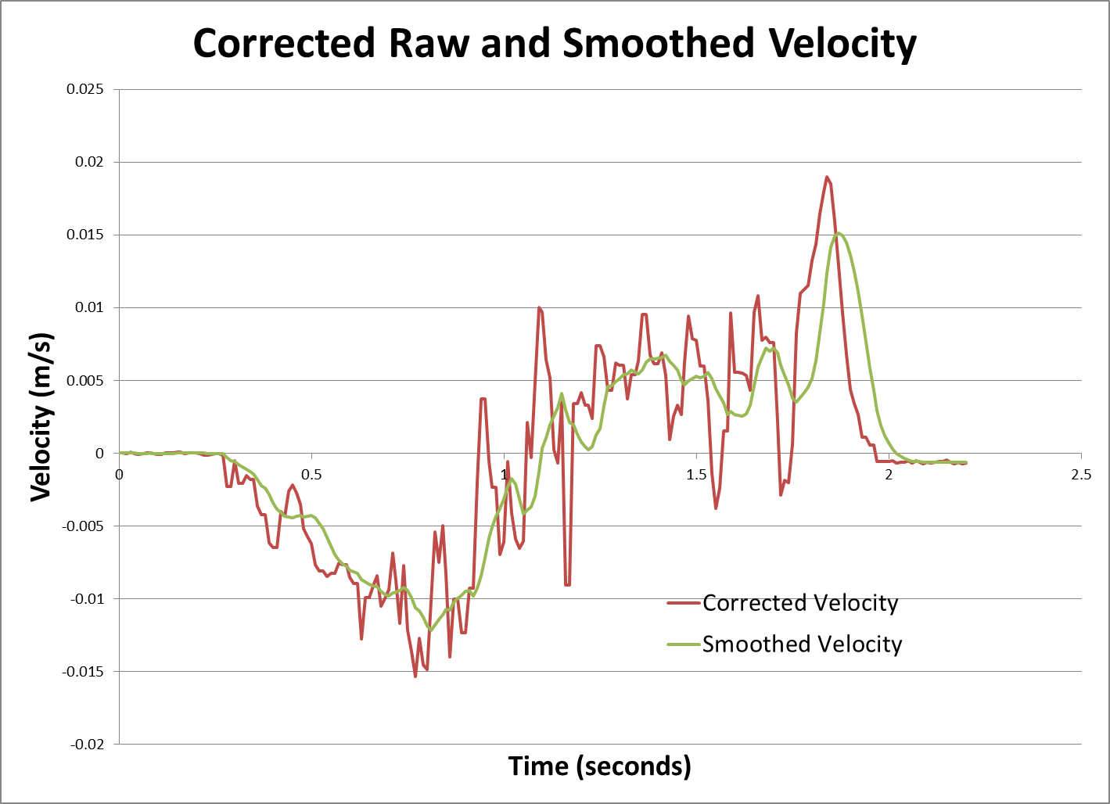
Velocity Low-Pass Filtered

Slide 66
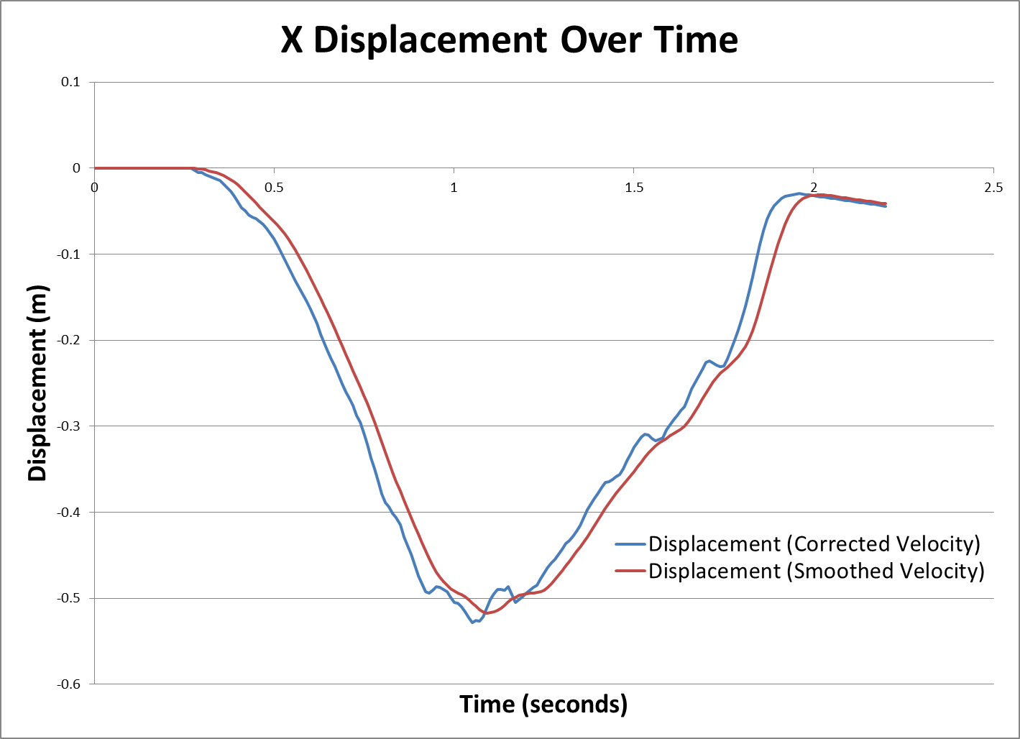
Resulting Displacement

